Slide 1
COMS W6998 SYSTEMS FOR HUMAN DATA INTERACTION
Eugene Wu
http://columbiaviz.github.io

Slide 2
Today’s class
Essentials
What is this class?
Getting to know you

Slide 3
Essentials.
Eugene Wu
421 Mudd (DSI space)
ewu@cs.columbia.edu
mention w6998 in the email title
OH: 4-5PM Tuesdays
Class: Weds 2-4PM, 488 CSB

Slide 4
Essentials.
TA: Yiru Chen
yiru.chen@columbia.edu
Mention “w6998” in the email title
OH: Tues 6-7PM

Slide 5
Essentials. Prereqs
Prereqs that are useful
4111 Intro to databases
Declarative languages and data independence
Relational algebra, SQL, relational model
Query optimization and execution
See Ramakrishnan, Gehrke for basics
4996 Intro to data vis
4170 User interface design
Great to have people with different backgrounds
Talk to me if unsure
If graduate student from different area, talk to me

Slide 6
Essentials. Waitlist
Submit first reviews by Monday midnight
First “assignment” by Monday midnight
Participate in first 2 classes
Waitlist decided based on submissions’ quality and participation

Slide 7
What is this class?
Initially a research reading group, but opened it up
Take what you want
Will not be taught (e.g., not a traditional lecture-based class)
Will not be tested (no exams, minor assignments)
You will conduct research
Read, comment on, discuss research papers and ideas
Do research project
It is hard!
Requires consistent work, ingenuity, and trial&error
If you haven’t done research at all before, talk to me

Slide 8
Course Goals
Study a research area: Data Management
Subarea: Systems for Human Data Interaction
Important in modern data-driven world/data-science
97% of world not programmers
100% of world revolves around data
Not just interface design, not just systems
Critically read and evaluate papers
Present research
Conduct novel, publishable research

Slide 9
Grading
Project: 50%
Participation: 45%
Paper reviews 10%
Class participation 20%
Presentation 15%
Assignments: 5%
No curve, everyone can get A
If project is amazing, automatic A
Since there are no textbooks/exams, assessment based on reviews and in-class discussions.

Slide 10
Class Format
Discussion group format
Submit reviews for ~2 papers by Monday midnight
(student/Wu leads) 15-20 min presentation.
(Wu leads) Deep dive into a specific section of paper
Why was it written that way? Argument structure
Sentence by sentence
(Wu leads) Open ended discussion/debug
What is great about the work?
What could be better
Everyone reads, prepares observations & Qs
Scribe takes notes during discussion
Signup to lead presentations. Scribes will be assigned

Slide 11
Reviews
10% of grade (lightly graded)
Submit Monday midnight before class
Shared with class
Can skip 4 paper reviews (note: 1+ papers per class)
Not late submissions accepted
What is the paper about?
What is significant (above prior work) and why?
Technical strengths beyond prior work: I like ….
Limitations: I wish ….
Extensions: What if ….?

Slide 12
Presentation
15% of grade
15-20 minutes (~1 slide/minute)
Cover key elements of paper (see prospectus)
Find & read related work to provide context
Intuition >> formulae
Create your own examples, don't download the authors' slides
Send slides/notes to Yiru by Monday midnight.

Slide 13
Presentation
By WHAT TIME choose what papers you want to present
Choose from reading list in the schedule, or others
Provide dates on when you cannot present

Slide 14
Participation
20% of grade
Deep dive: dissect a section of text
Go sentence by sentence
Understand why it was written in a particular way
Discussion: open-ended debate of paper
What could authors have done better?
What did authors do well?
What are related ideas? How could it be extended?
Be prepared with questions and thoughts

Slide 15
Assignments
5% of grade
Goal: try using the systems described in the papers yourself
Not meant to be burdensome.
~4 assignments throughout the semester
Assessment based on honest effort

Slide 16
Research Project
50% of grade
Goal
Build/design/evaluate something new and cool
Project that is ~publishable in an HDI conference/workshop
Go Big!
Time line
Initial Prospectus 2/12 3 weeks (5%)
Related Works 3/4 3 weeks (5%)
Prototype Check-in 3/25 3 weeks (5%)
Project Showcase 4/29 5 weeks (10%)
Report 5/10 1 week (25%)

Slide 17
Research Project
Often, “I want to build X with features A, B, C”
Ignores why it’s worthwhile and new
Confuses artifact as the goal
The most important aspect of research: clear hypothesis
Is it worth asking? Based on existing work, user needs
Can be answered? Based on specificity and scope of hypothesis question.
Has it been answered correctly? Based on methodology

Slide 18
Research Project
If project is a perceptual/user study
Focus is on the task that the study will better illuminate
Show: new understanding of users
If project is a system/tool/interaction design
Focus is on the task that is improved
Show: novelty, performance, ease of use
If project is an algorithm
Focus is an existing or new task
Show: novel, correctness, scalability

Slide 19
Research Project
Teams of 1-2. Expected work proportional to team size
We are here to help you succeed
Week 3: pick problem answerable in 3-5 weeks.
Discuss with staff before this stage
Week 6: thorough review of related works
Convince us your project is new
Position relative to state of the art
Play with related tools
Week 11: prototype of system/algorithm/project
Week 14: showcase your project
Week 15: submit final paper

Slide 20
Research Project
Many possible example projects
A tool to automatically detects data errors or violations
A scatter-plot tool that scales to 10M datapoints
A new approximate query processing system based on operating on models instead of data
A new algorithm for human-supervised categorization
Extending an existing algorithm to handle a new setting or domain
<insert your domain specific tool, especially encouraged!>

Slide 21
Questions about Essentials?

Slide 22
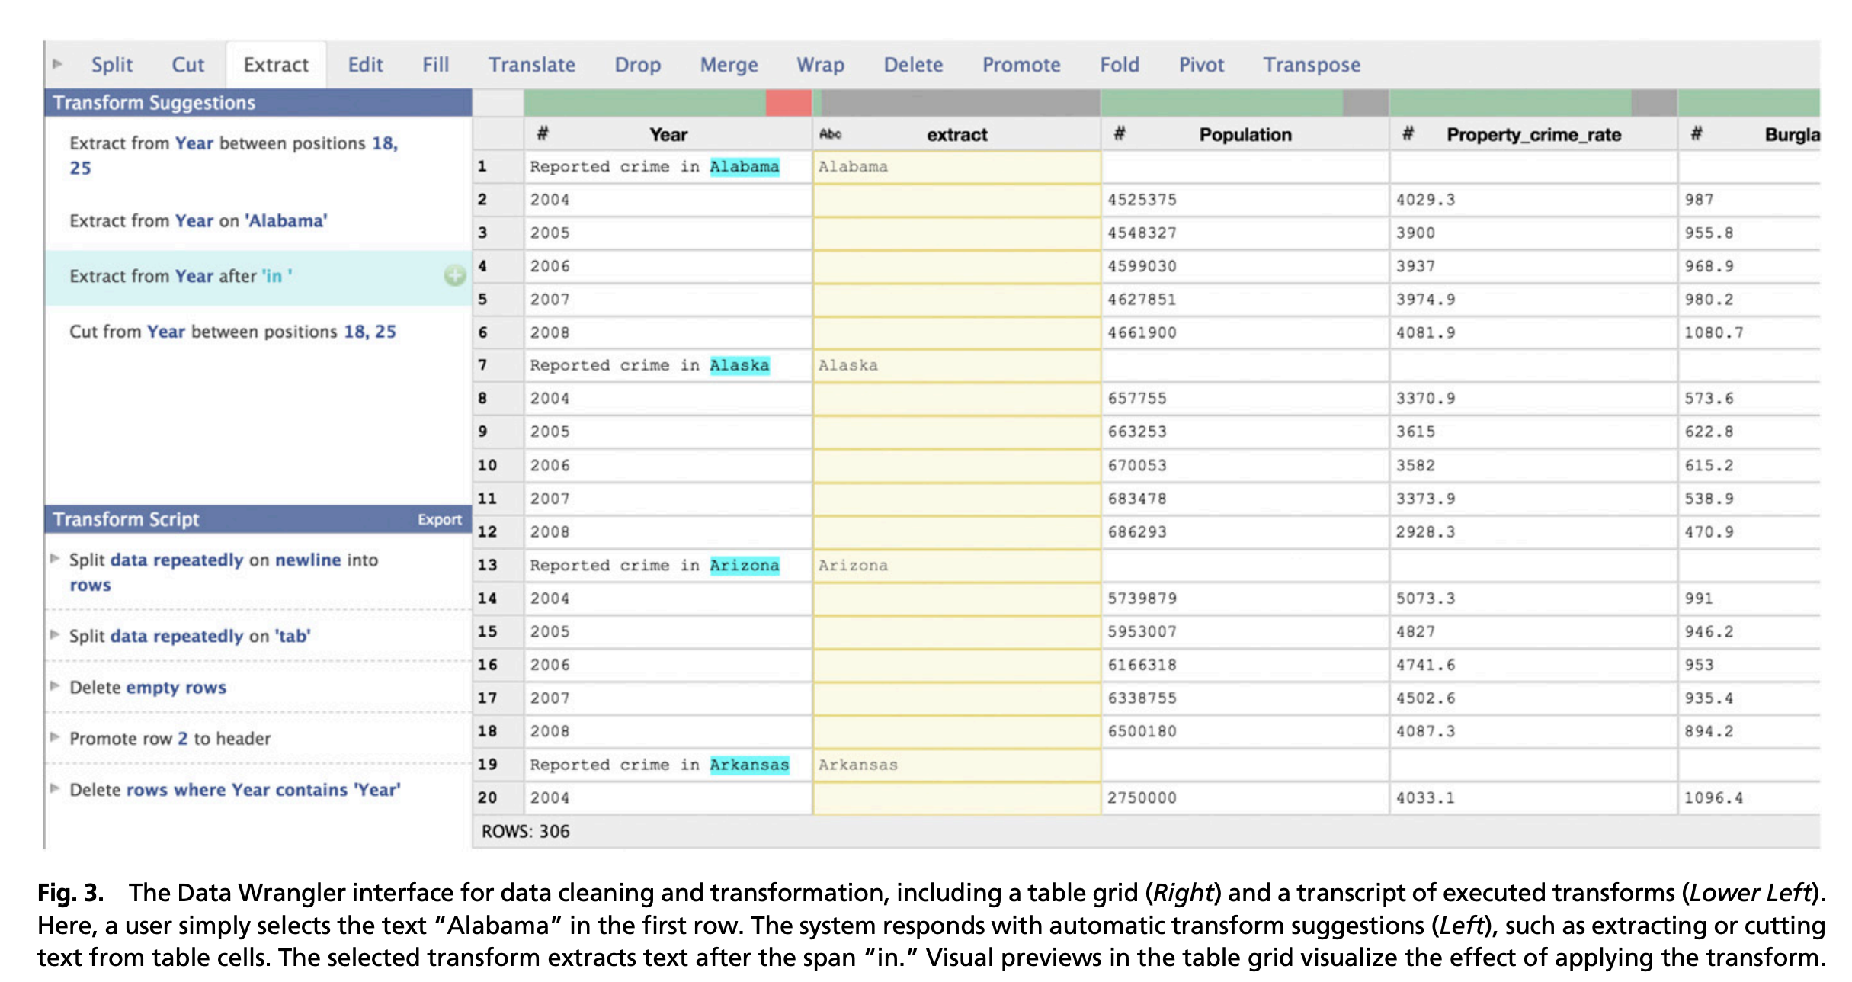

Slide 23
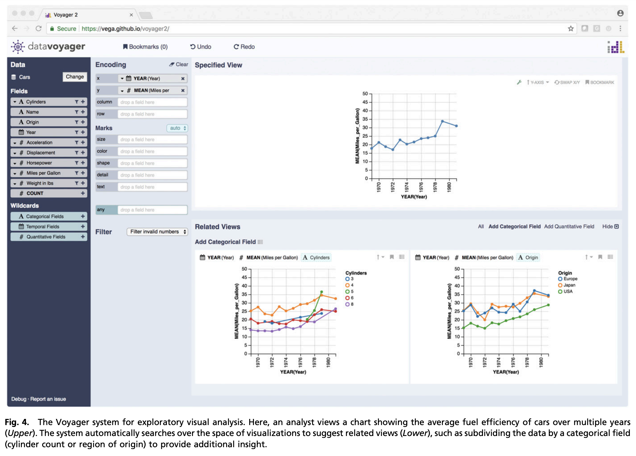

Slide 27
Your Tasks for next class
Submit reviews Monday midnight
Submit Assignment 1 Tuesday midnight

